Slide 1


SCIE5508 Synthetic Biology – Solving global challenges
Workshop 1 – Designing orthogonal circuits based on extractytoplasmic function (ECF) σ factors
Dr. Georg Fritz
Senior Lecturer
School of Molecular Sciences

Slide 2
Roadmap for today
Recap of ECF-based synthetic circuits
Recap of MoClo system
Introduction to Geneious: Build your first GFP expression cassette
Hands-on: in silico cloning of your own ECF circuit

Slide 3
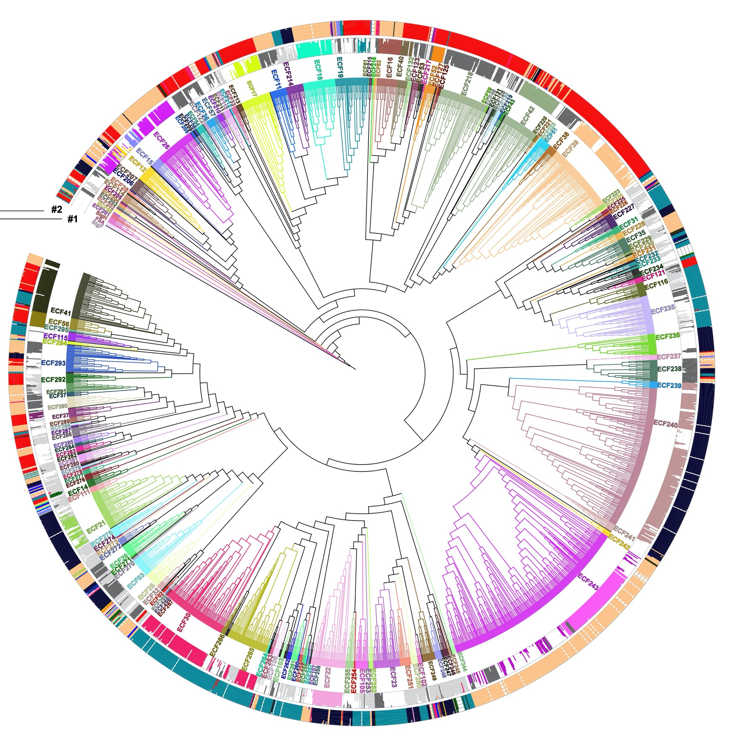
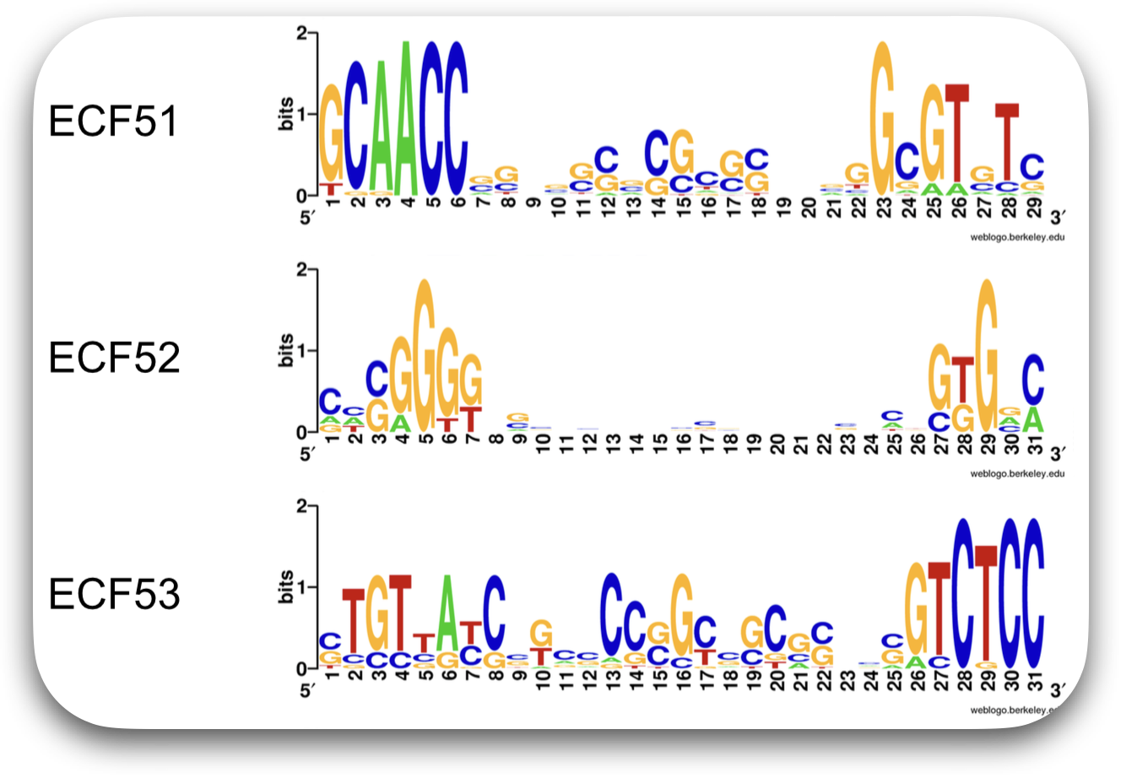
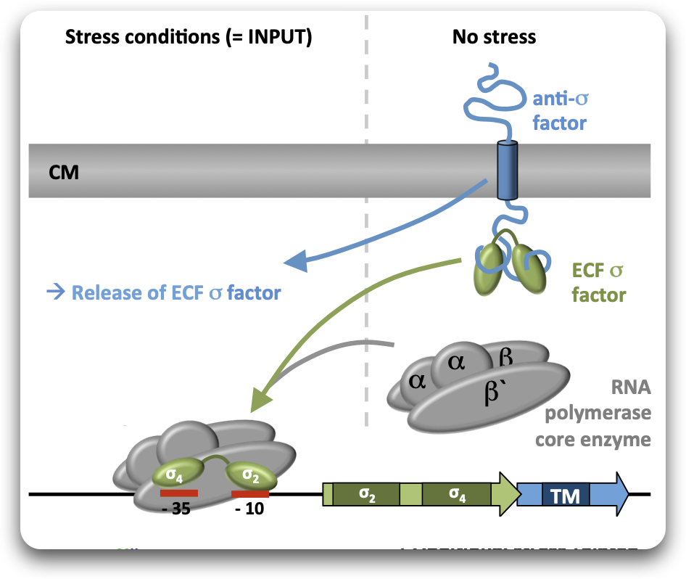
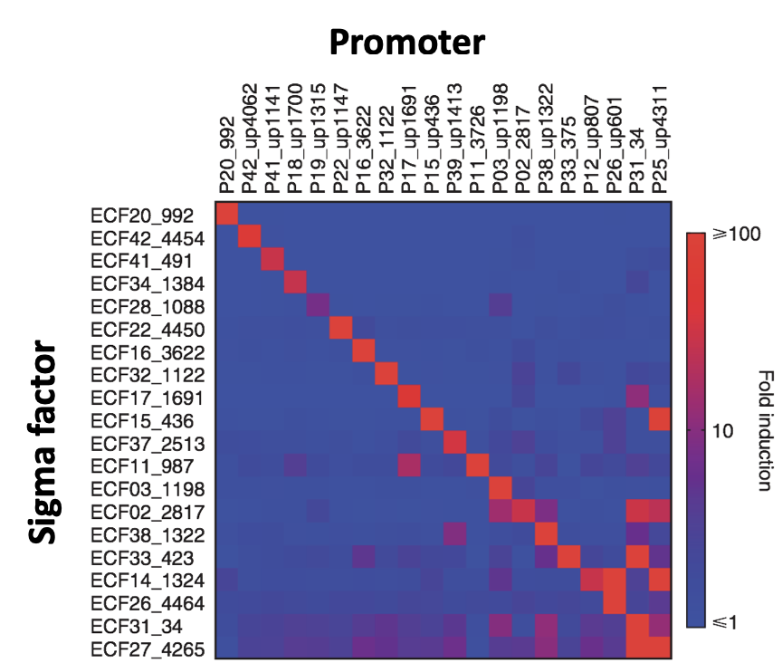
Circumventing regulatory cross-talk through orthogonal systems
Extracytoplasmic function (ECF)
σ factors control orthogonal regulons under stress conditions
Diverse ECF groups feature different promoter preference
157 ECF
groups
Huang, Pinto, Fritz & Mascher, J. Bacteriol. (2015)
Casas-Pastor et al, bioRxiv (2019)
https://doi.org/10.1101/2019.12.11.873521
Heterologous expression of ECFs from diverse species in E. coli leads to recognition of cognate promoters
Mascher, Curr. Opin. Microbiol. (2013)
Rhodius, et al., Mol. Syst. Biol (2013)

Slide 4
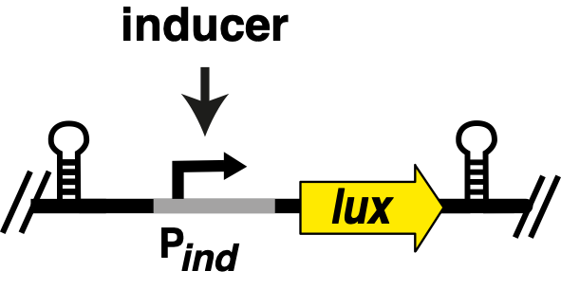
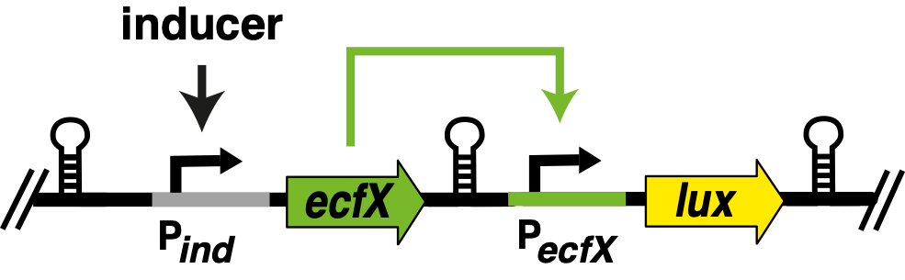
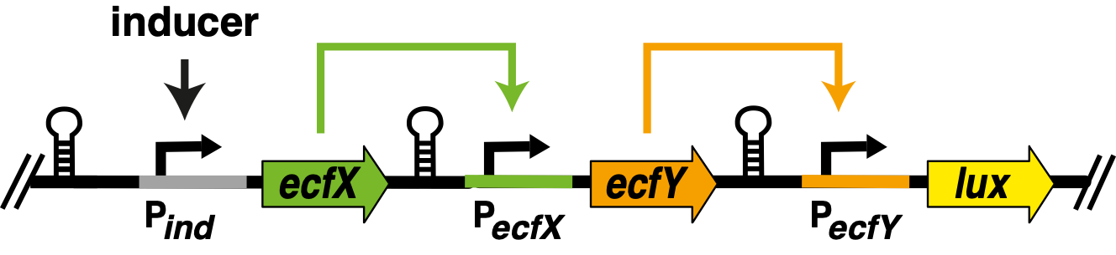
Pinto et al provide proof of concept:
Building autonomous timer circuits
+ind
+ind
+ind
time delay

Slide 5







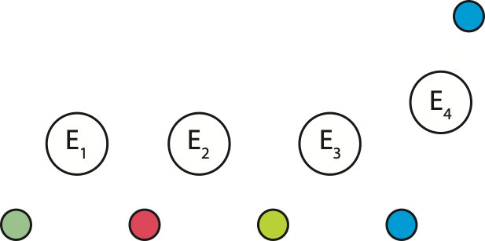
Application of autonomous timer circuits
Silent gene cluster
Natural product
Synthetic
Biology
Relative timing
E1
protein level
E2
E3
E4
t0
time
Expression host

Slide 6
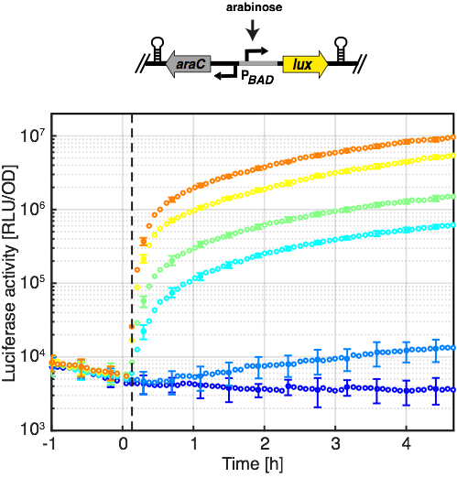
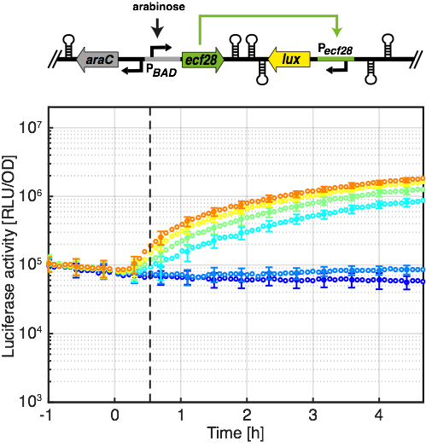
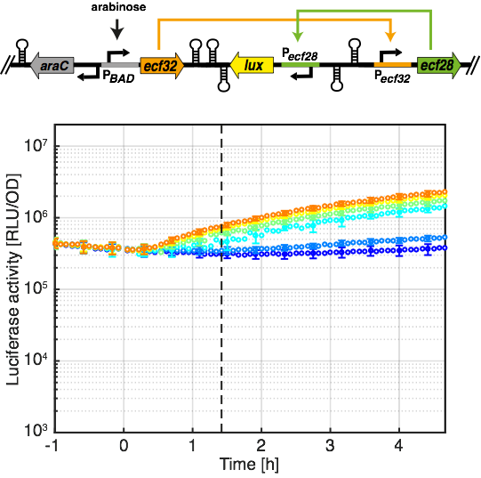
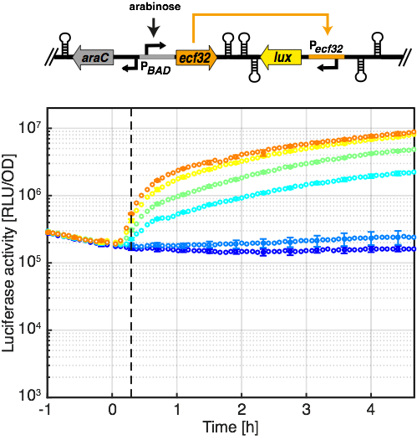
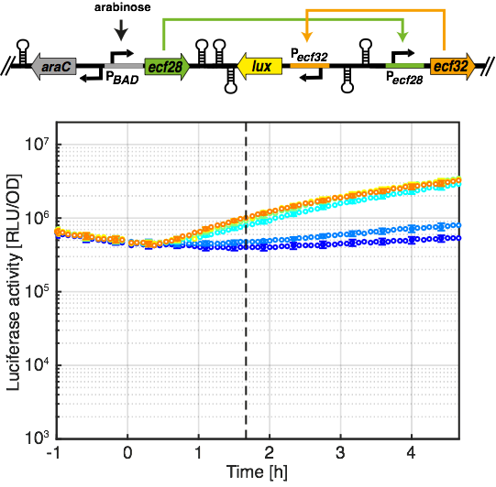
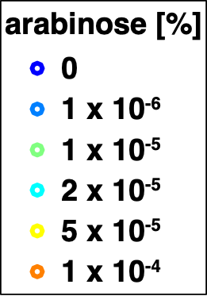
Autonomous timers in E. coli
30’
85’
15’
100’
Pinto, Vecchione et al.,
NAR, 2018

Slide 7
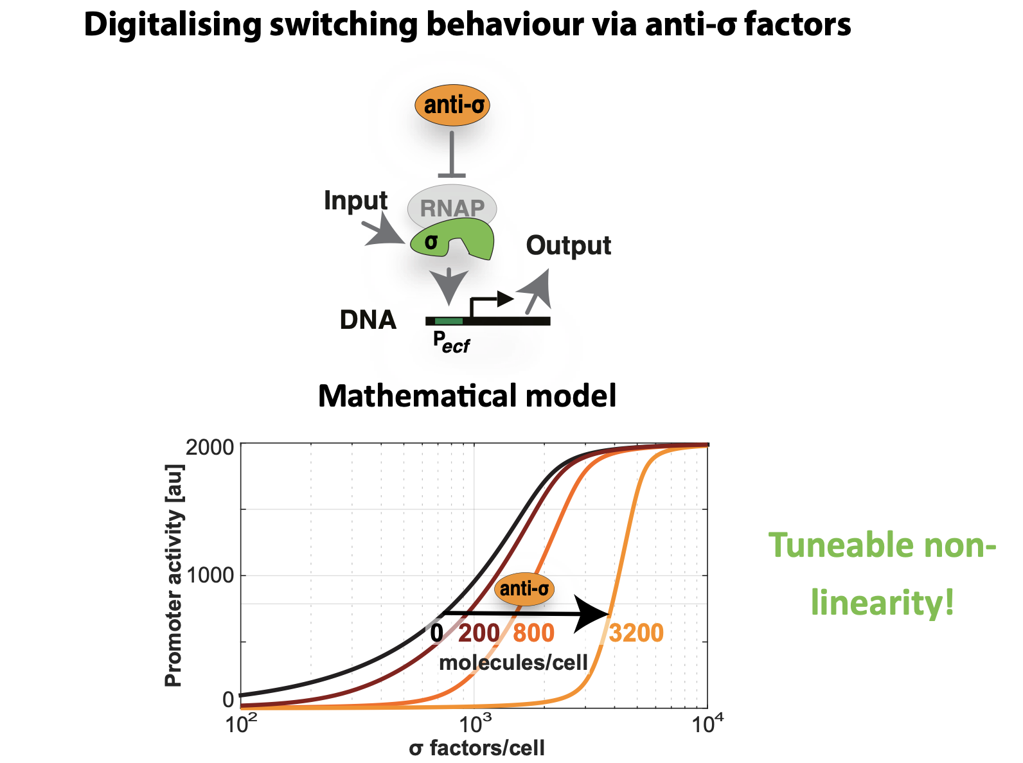

Slide 8
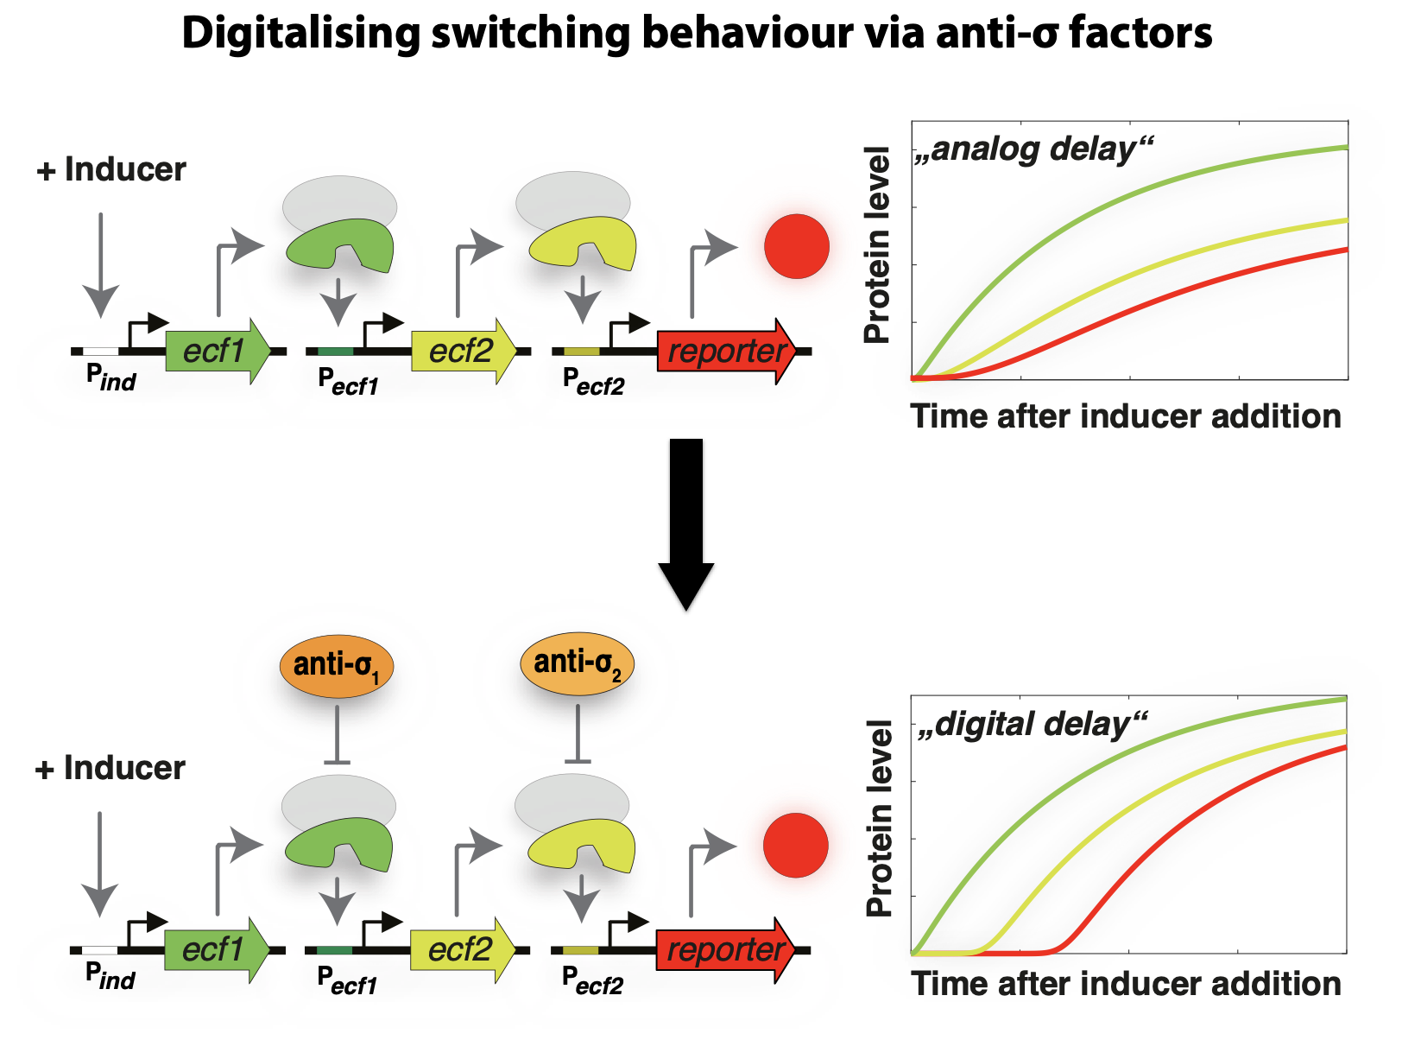

Slide 9
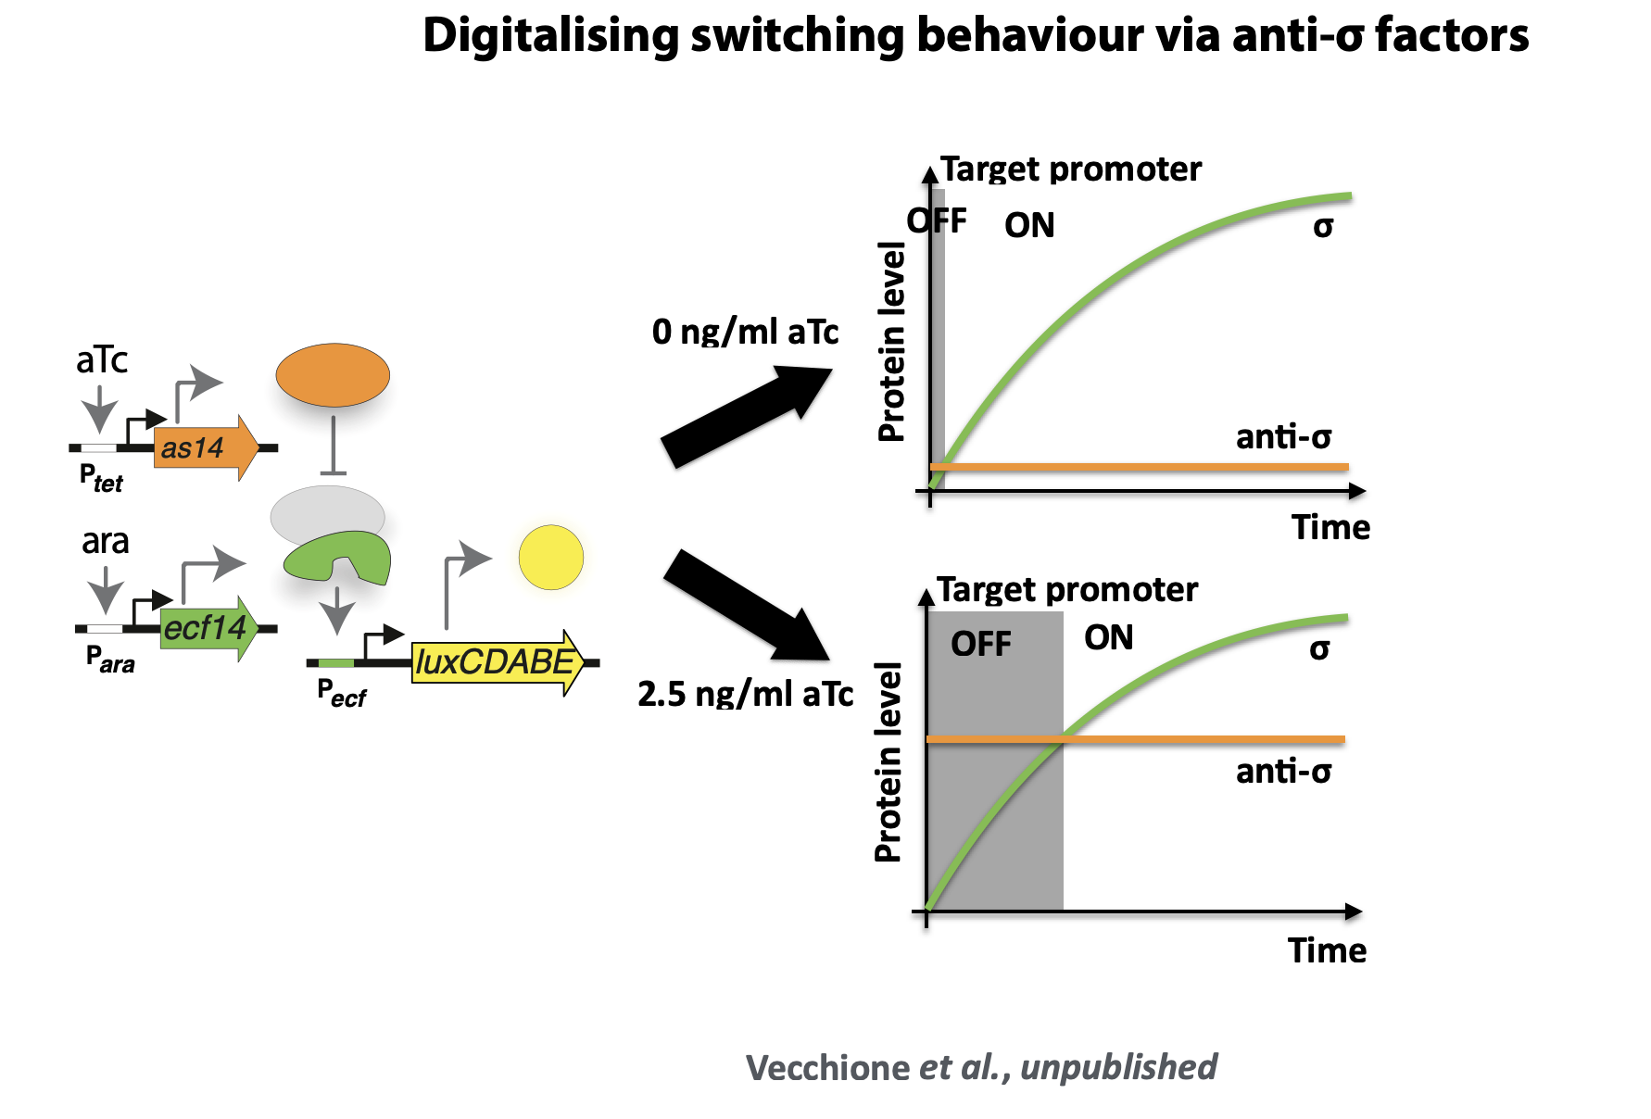

Slide 10
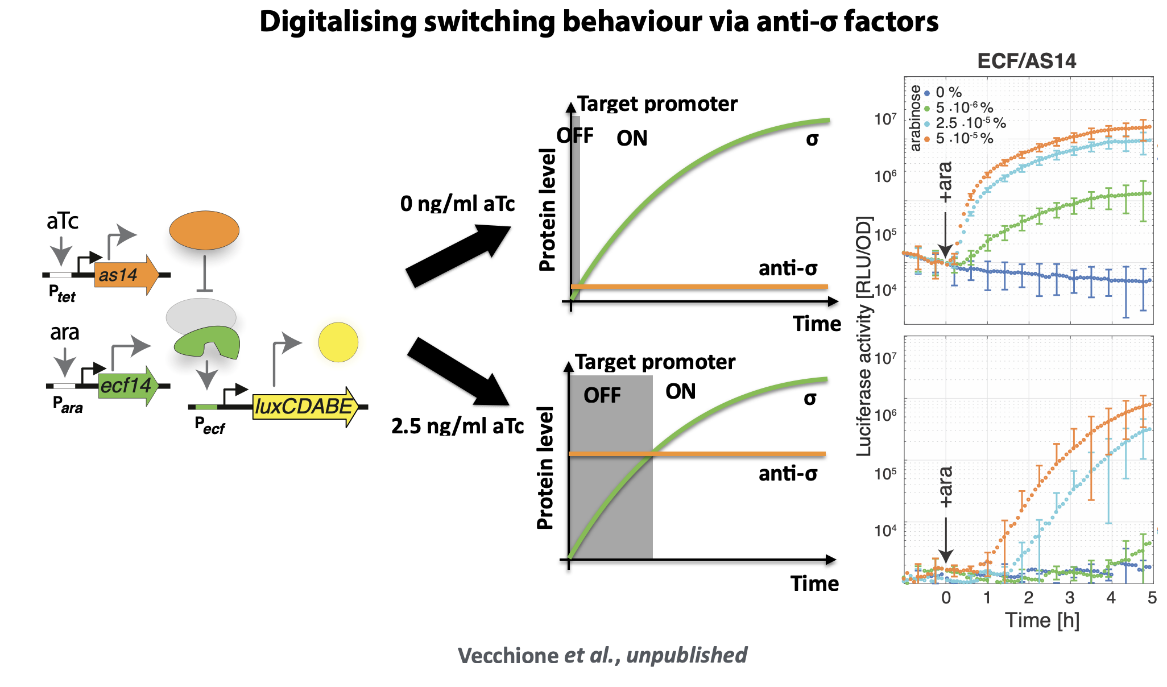

Slide 11


Goal of this workshop
ECF σ
P_{ecf}
RBS
Anti-σ
Design your own circuit
Plasmids
Terminator

Slide 12
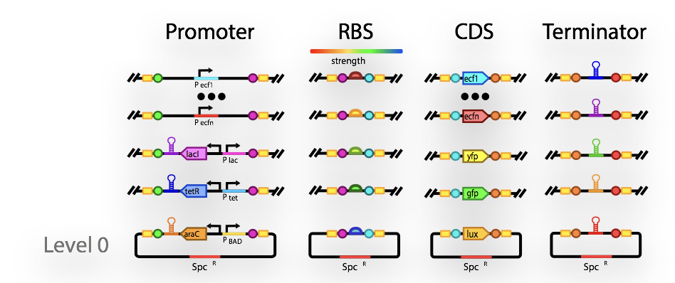
Library of parts
3 inducible promoters (ara, IPTG, aTc)
3 constitutive promoters
9 ECF promoters
3 RBS of different strength
9 ECF’s
7 AS’s
5 reporter genes
10 non-homologous terminators
Available on LMS: SCIE5508_workshop1.geneious

Slide 13
How to design a genetic circuit?
1. Concept
(anticipate desired function in a wiring diagram)
Detail

Slide 14
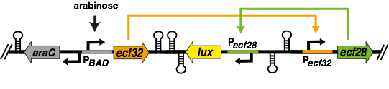
How to design a genetic circuit?
1. Concept
(anticipate desired function in a wiring diagram)
Detail
2. Genetic design (envisage the parts used, orientation of genes, which plasmids to use, …)

Slide 15
How to design a genetic circuit?
1. Concept
(anticipate desired function in a wiring diagram)
Detail
2. Genetic design (envisage the parts used, orientation of genes, which plasmids to use, …)
MoClo level
1-1
1-2
1-3
1-4
1-5
TU
Insulator
TU
Insulator
TU
3. In silico Golden Gate assembly in Geneious bioinformatics software

Slide 16

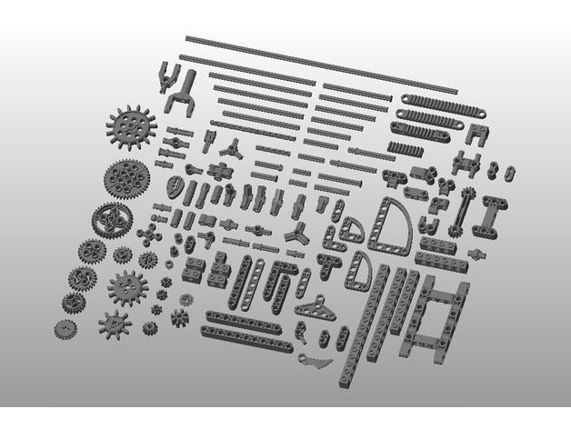
How to build it?
!
???

Slide 17
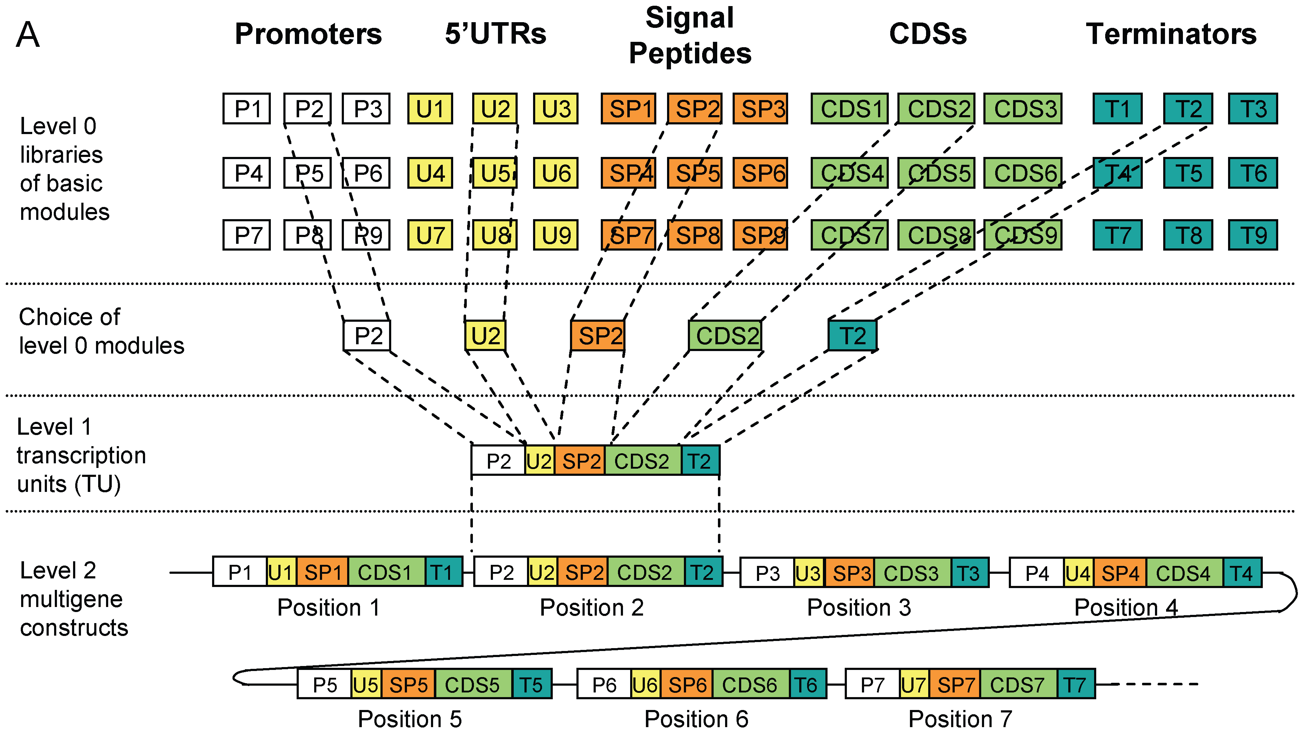
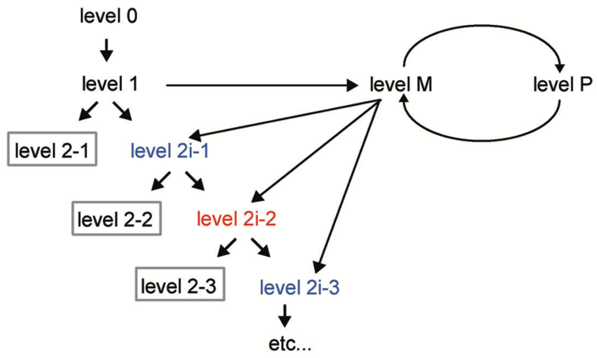
Recap of the modular cloning (MoClo) standard
Stefan Werner, Carola Engler, Ernst Weber, Ramona Gruetzner & Sylvestre Marillonnet (2012) Fast track assembly of multigene constructs using Golden Gate cloning and the MoClo system, Bioengineered, 3:1, 38-43, DOI: 10.4161/bbug.3.1.18223
Weber E, Engler C, Gruetzner R, Werner S, Marillonnet S (2011) A Modular Cloning System for Standardized Assembly of Multigene Constructs. PLOS ONE 6(2): e16765. https://doi.org/10.1371/journal.pone.0016765

Slide 18
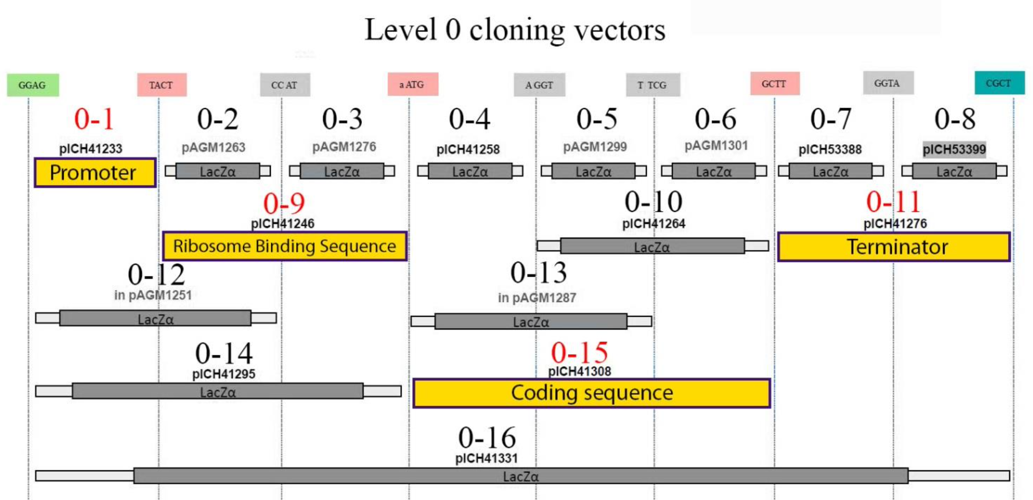
Our part library is stored in vectors containing
these fusion sites

Slide 19
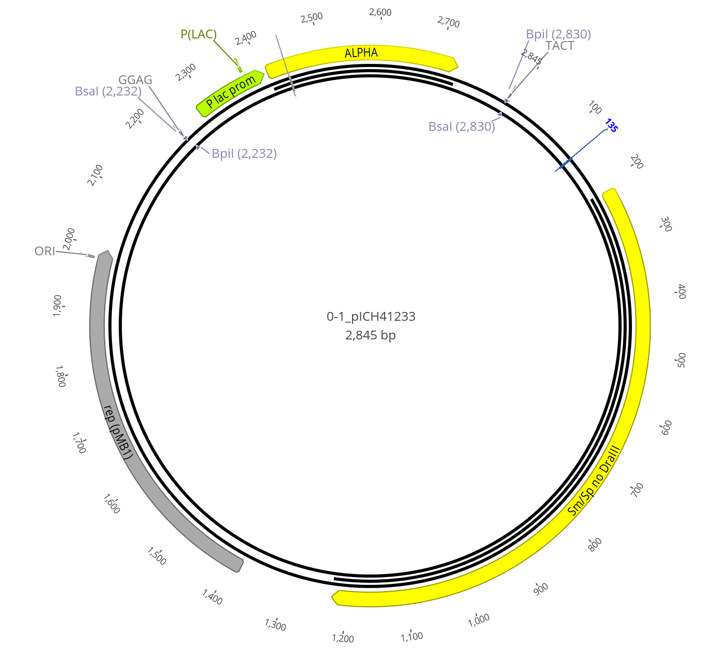
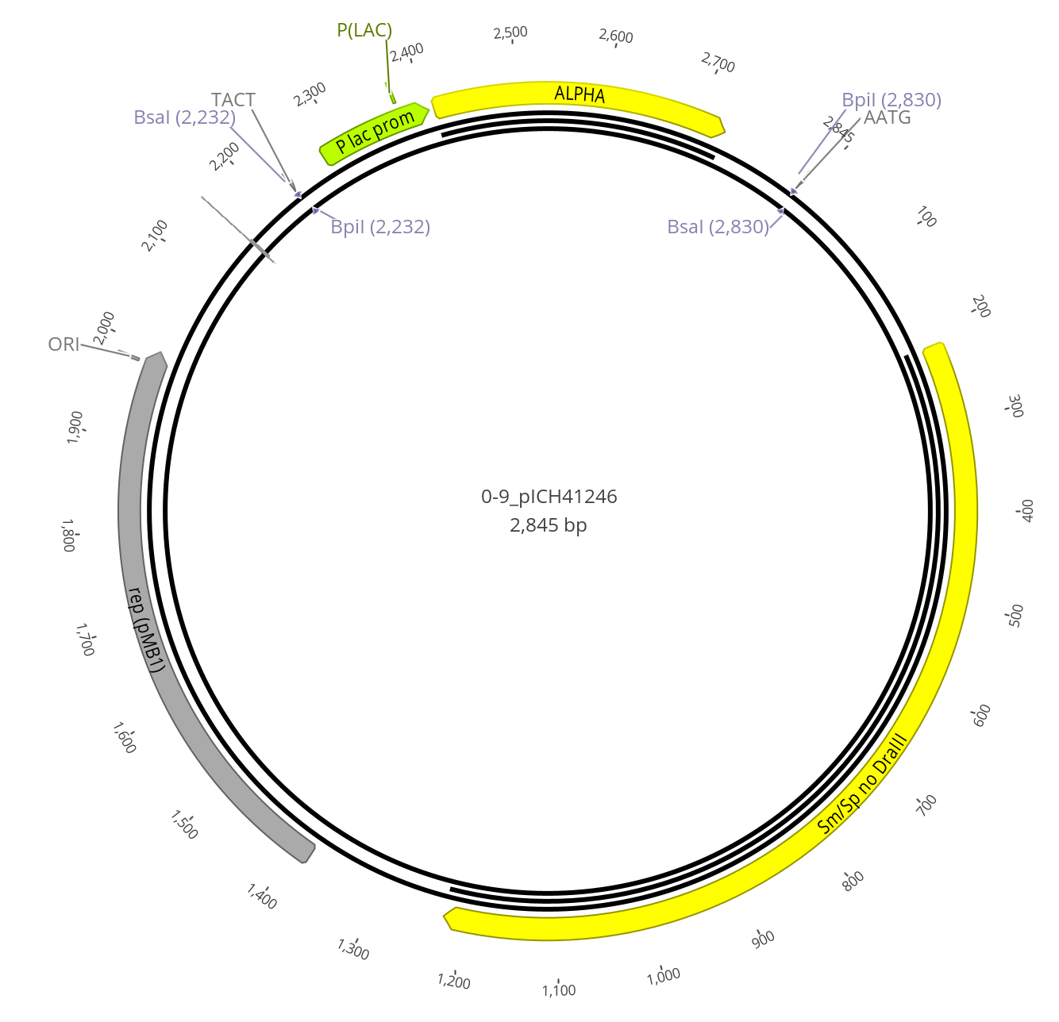
Examples of level 0 entry vectors
Level 0-1 (empty)
Level 0-9 (empty)

Slide 20
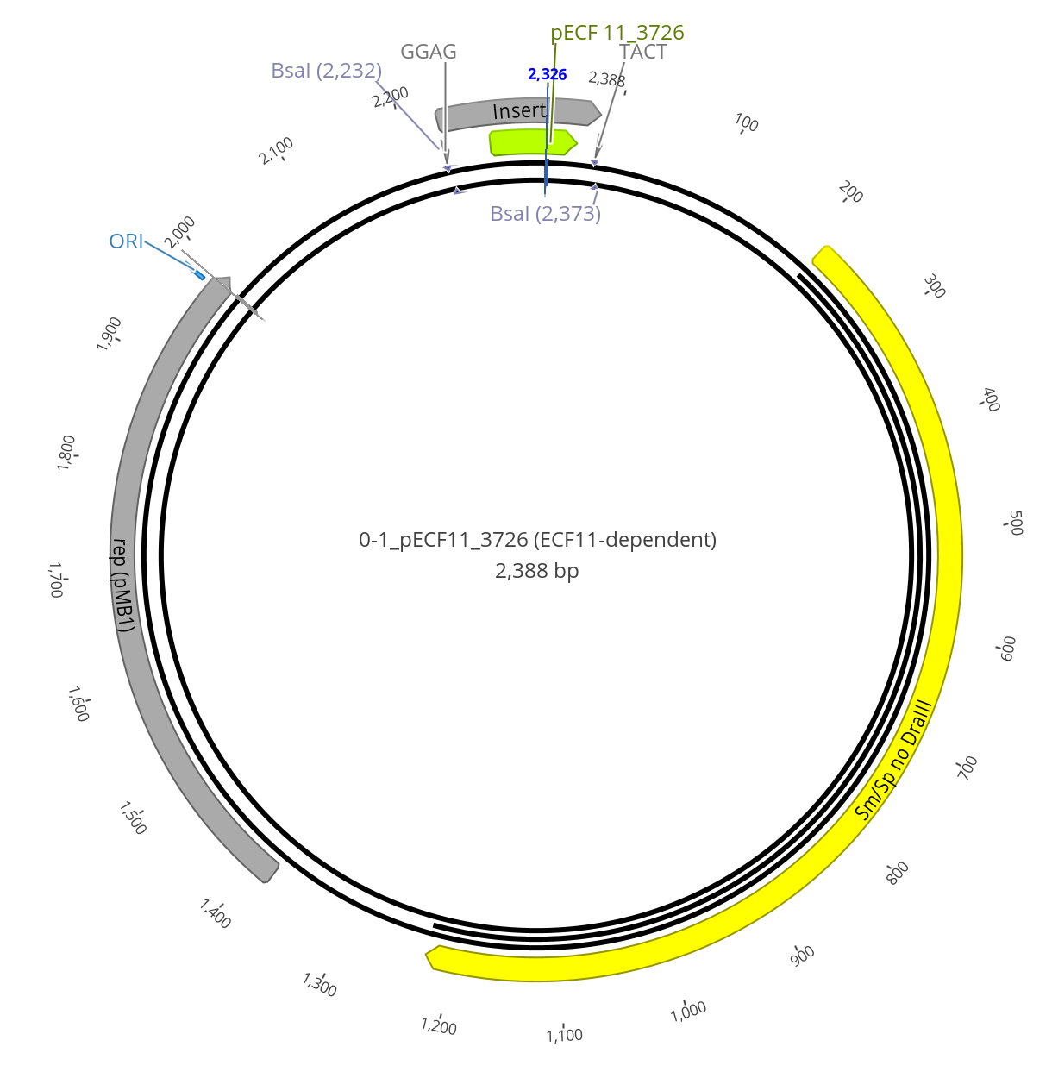
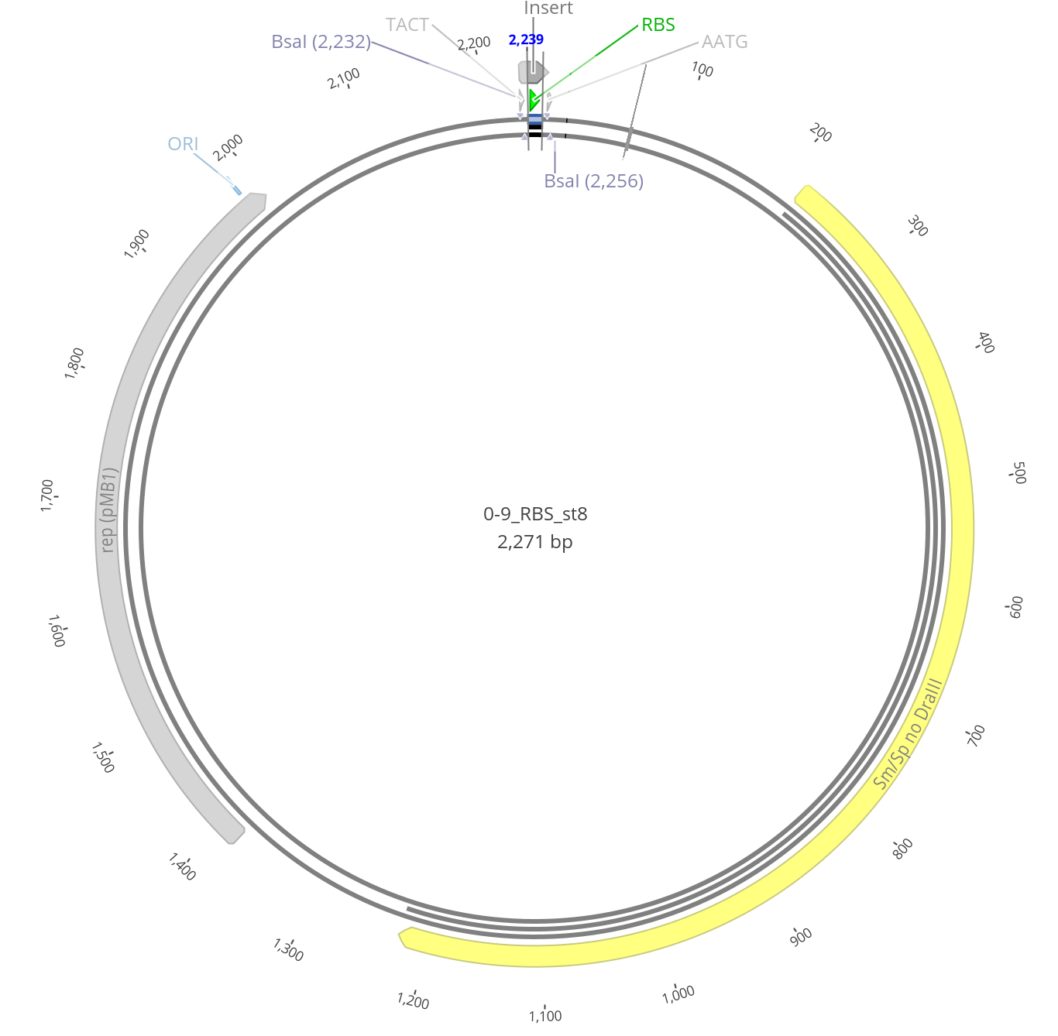
Examples of “loaded” level 0 vectors
Level 0-1 (Promoter)
Level 0-9 (RBS)

Slide 21
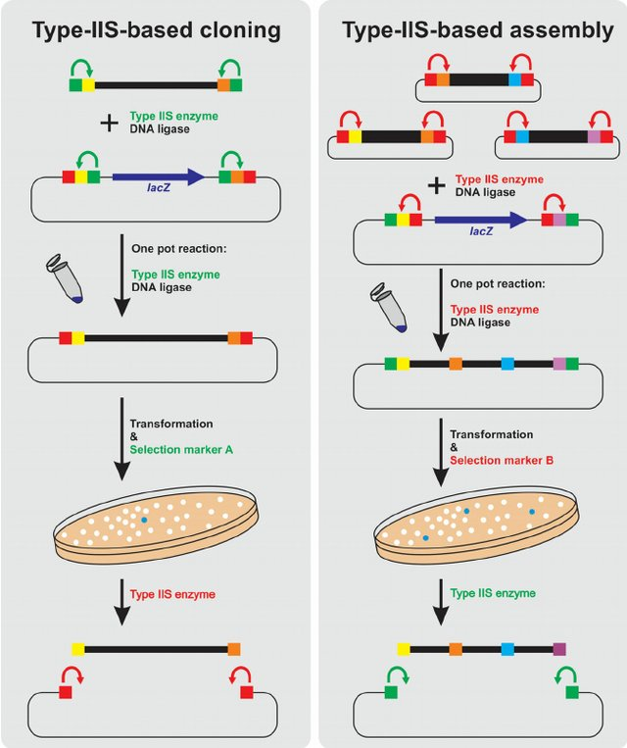
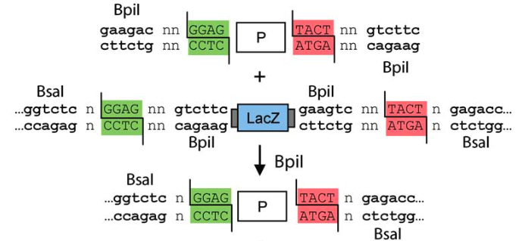
Building level 0 parts
PCR product
Level 0 entry vector
BpiI
Level 0 module
Re-ligated vector
= blue colony
BsaI
Level 0 part release

Slide 22
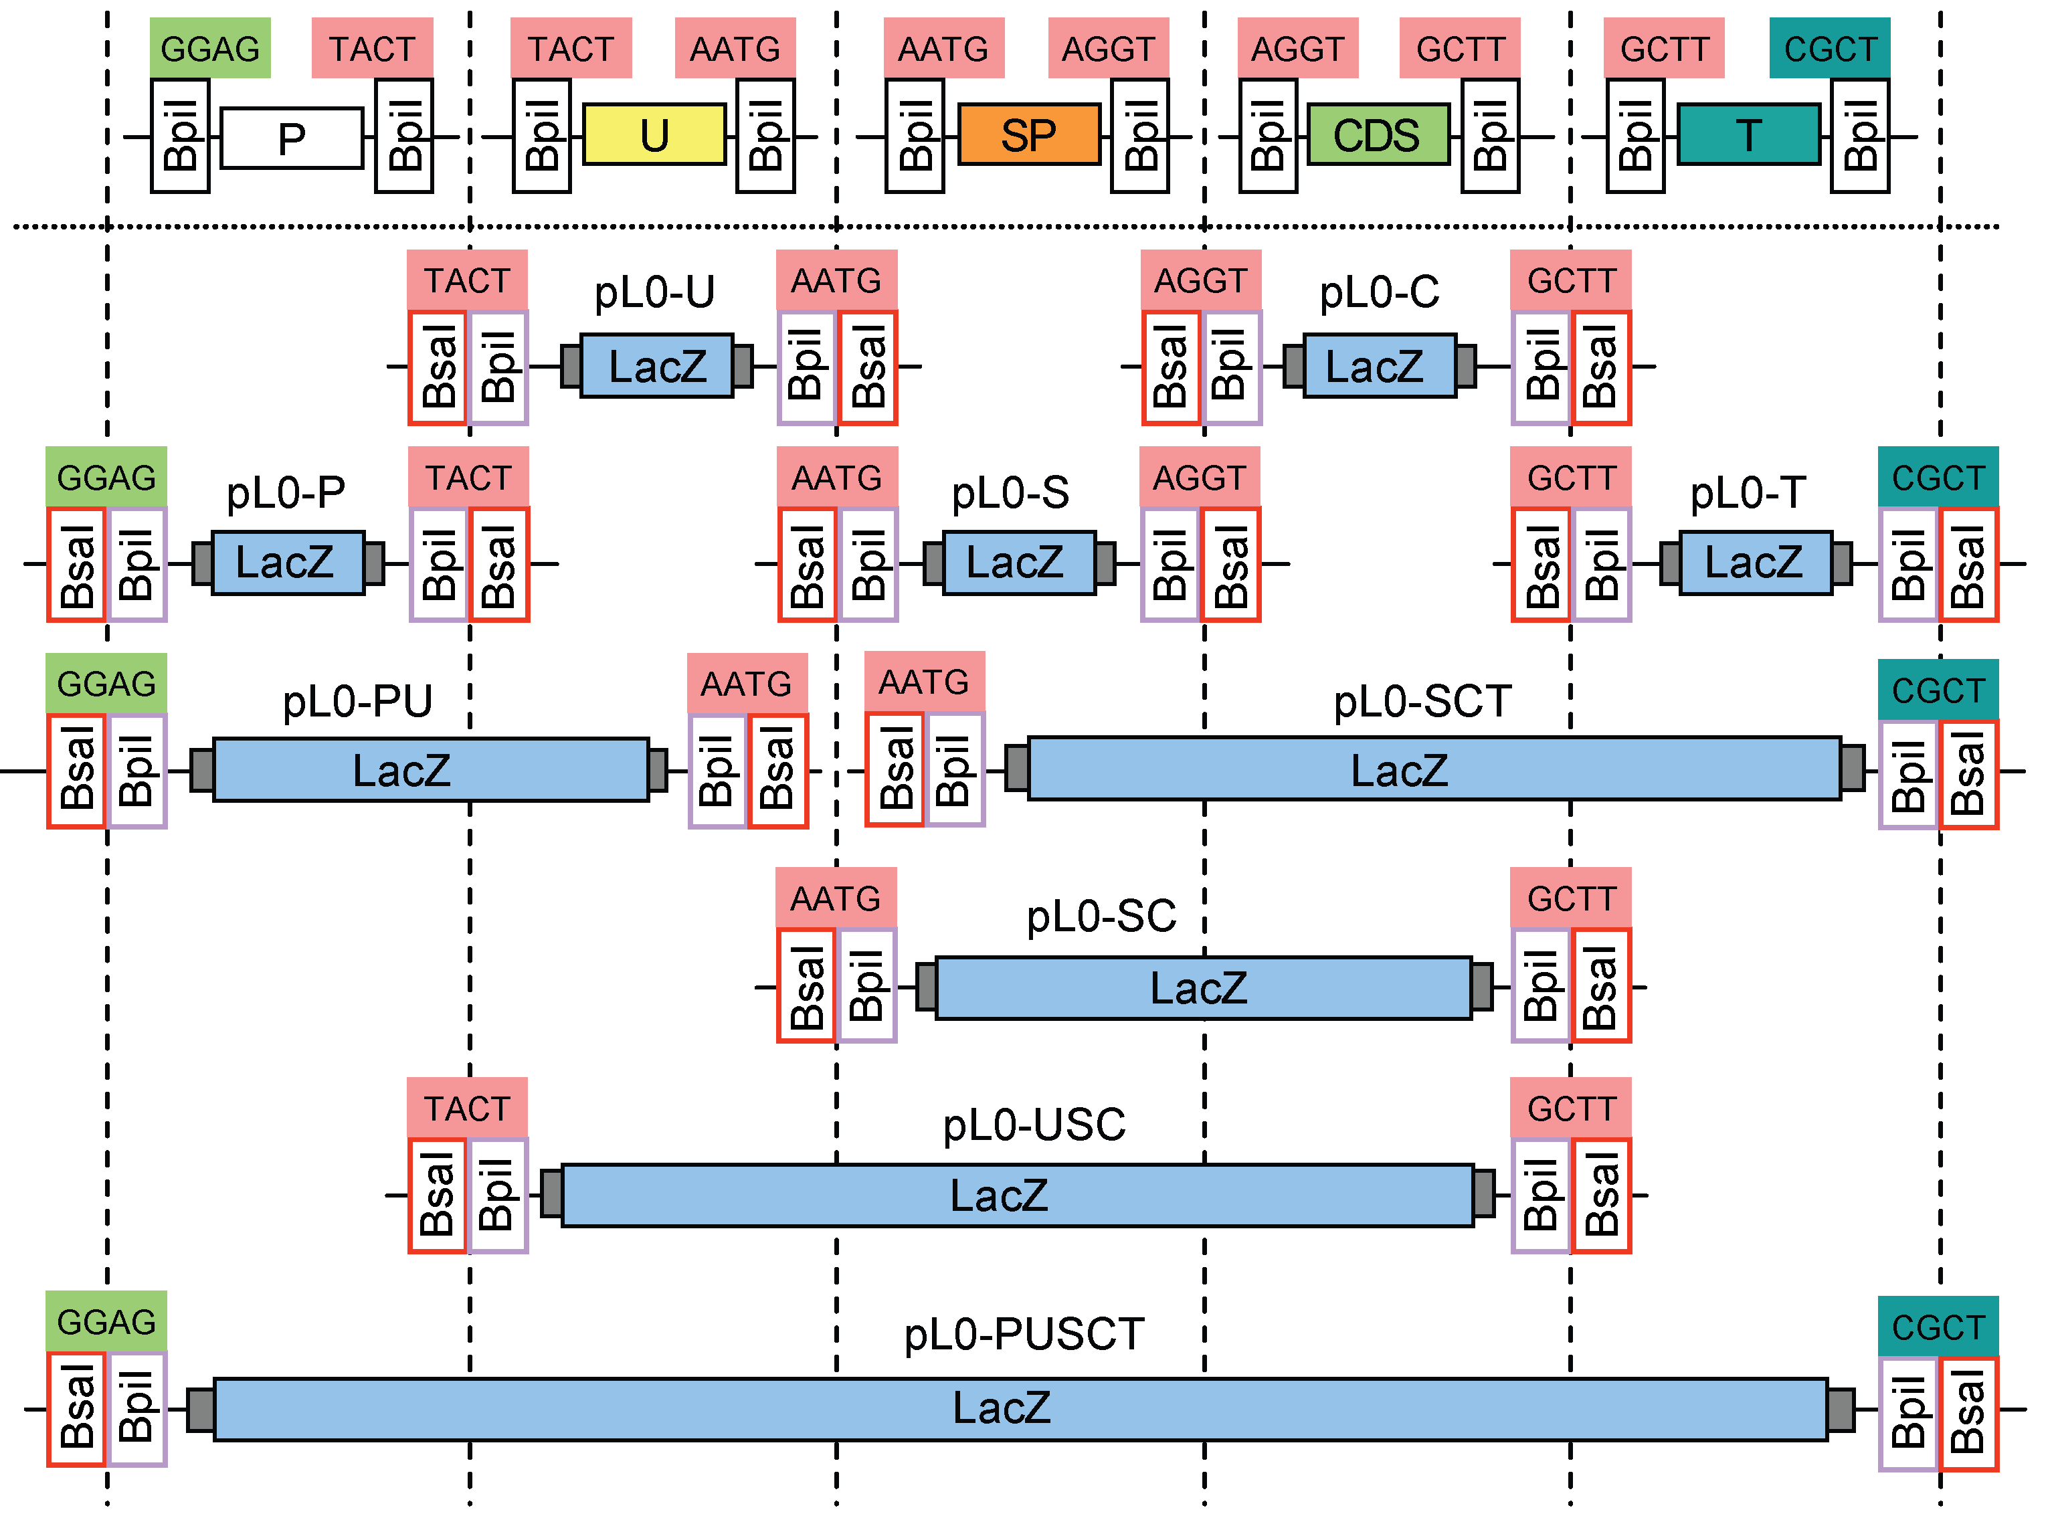
Building level 0 parts
Signal peptide
Coding
sequence
promoter
5’ UTR
Terminator
PCR product
Level 0 entry vector
BpiI
Level 0 module
Level 0 entry vectors (Spec^{R})
Re-ligated vector
= blue colony
BsaI
Level 0 part release

Slide 23
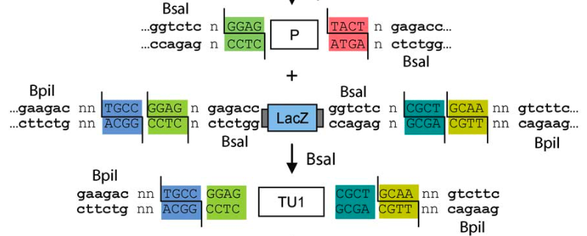
Building level 1 transcription units (TUs)
Level 0 modules
Level 1 destination vector
BsaI
Level 1 transcription unit
Re-ligated vector
= blue colony
BpiI
Level 1 part release

Slide 24
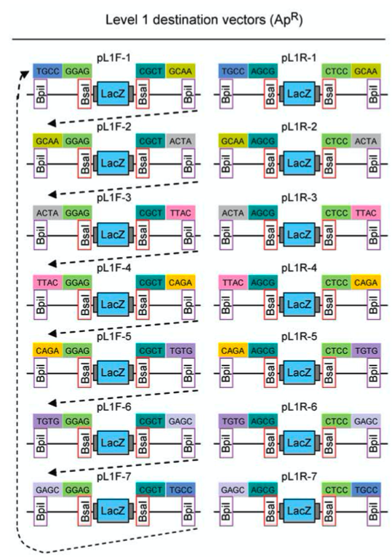
Building level 1 transcription units (TUs)
Level 0 modules
Level 1 destination vector
BsaI
Level 1 transcription unit
Re-ligated vector
= blue colony
BpiI
Level 1 part release
Positions 1-7
(reverse orient.)
Positions 1-7

Slide 25


Hands on!
Find your team mates!
Start software
Make sure MoClo library is imported (drag & drop MoClo collection.geneious to your Sources folder)
Check out part library
Visualize restriction sites, add annotations, etc.
Start test assembly: Build a GFP/RFP dual expression cassette

Slide 26
Now: build a more complex genetic design in MoClo
Design:
Convergent & divergent TUs separated by insulators (100’s of bp random DNA + terminators)
1-1
1-2
1-3R
1-4
1-5
MoClo level
TU
Insulator
TU
Insulator
TU
eLM3
M-1
M-4
eLM5
eLP5
P-1

Slide 27
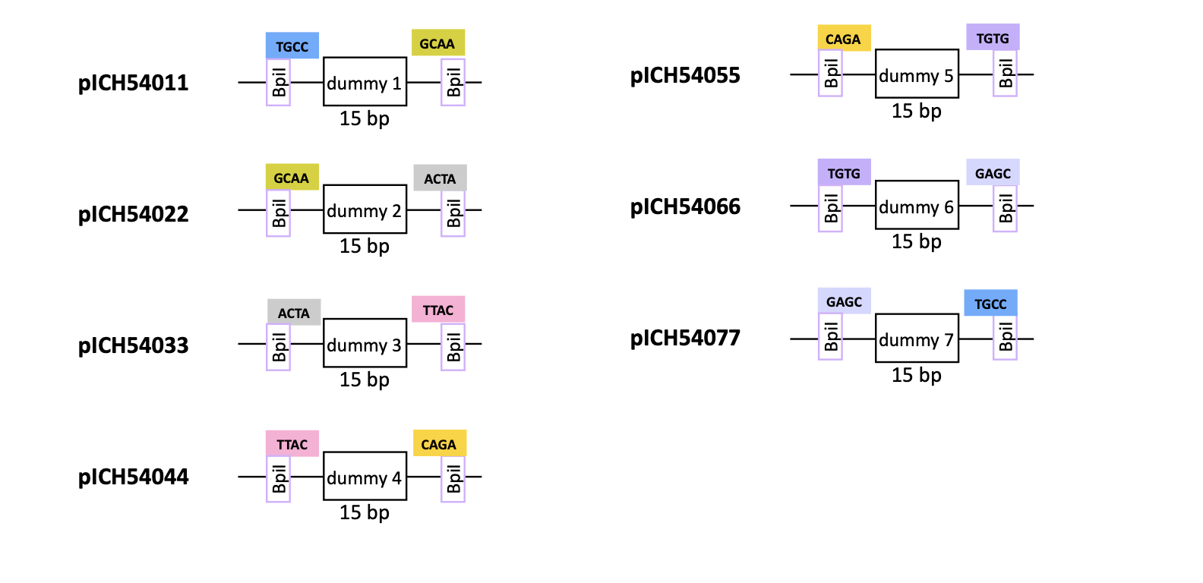
Dummies to close ”gaps” in the design
15 bp dummies for level 1 parts
15 bp + 300 bp dummies for level 0 parts

Slide 28
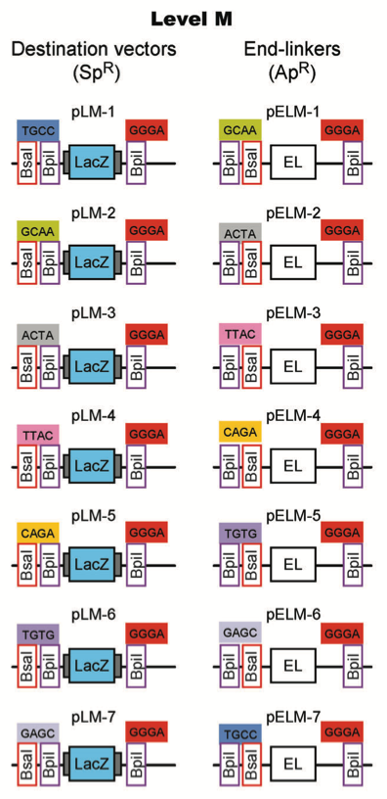
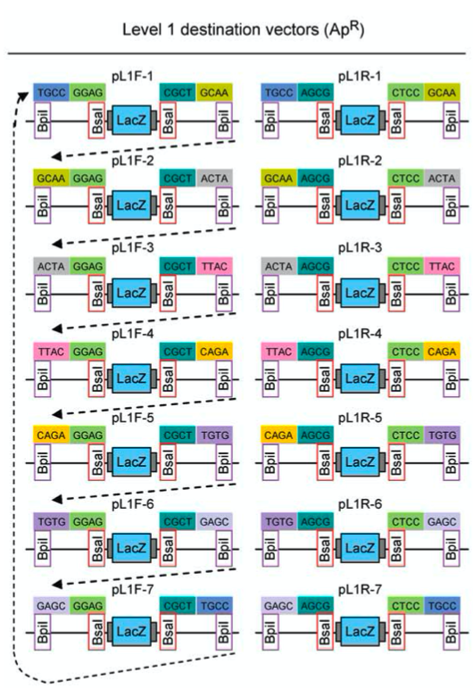
Building level M circuits
Level 1 transcription units
Level 2 destination vector
BpiI
Level 2 circuit
Re-ligated vector
= blue colony
BsaI
Level 2 part release

Slide 29
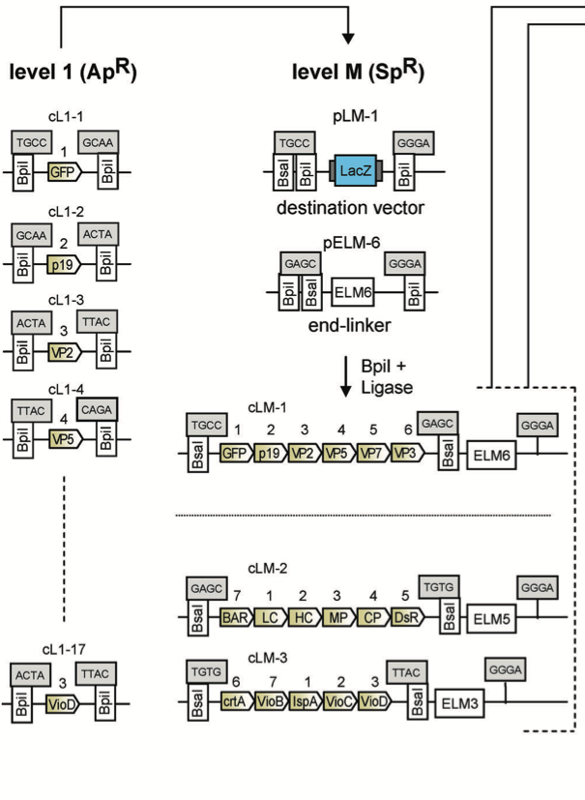
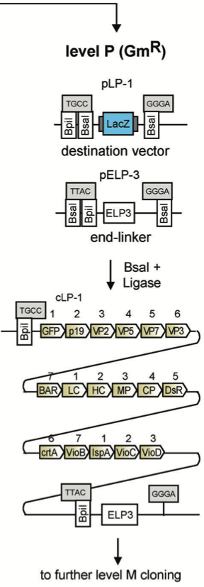
From level 1 TUs to level P circuits
cLM-7
cLM-6
Stefan Werner, Carola Engler, Ernst Weber, Ramona Gruetzner & Sylvestre Marillonnet (2012) Fast track assembly of multigene constructs using Golden Gate cloning and the MoClo system, Bioengineered, 3:1, 38-43, DOI: 10.4161/bbug.3.1.18223

Slide 30
From level 1 TUs to level P circuits
cLM-7
cLM-6
Stefan Werner, Carola Engler, Ernst Weber, Ramona Gruetzner & Sylvestre Marillonnet (2012) Fast track assembly of multigene constructs using Golden Gate cloning and the MoClo system, Bioengineered, 3:1, 38-43, DOI: 10.4161/bbug.3.1.18223

Slide 31
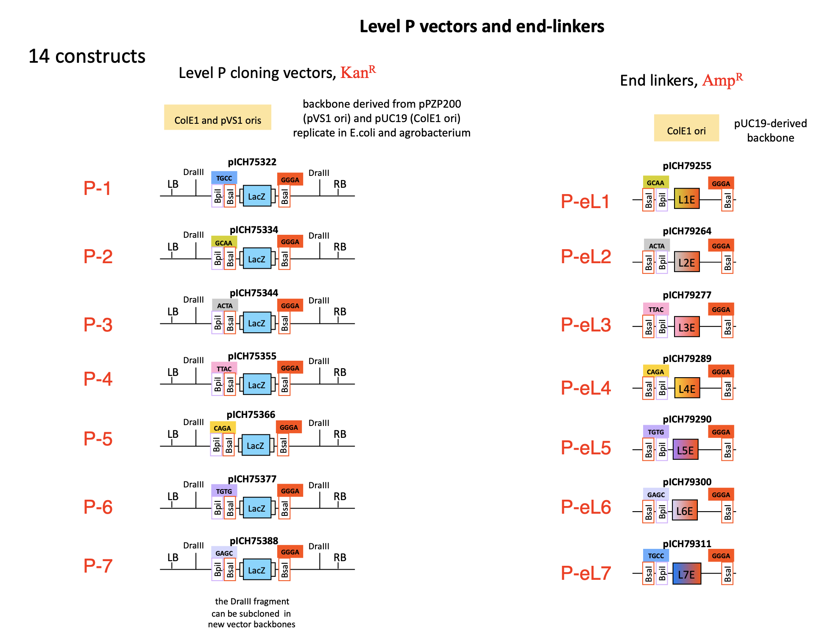

Slide 32

Questions?

Slide 33
Summary
Deep dive into ECF-based synthetic circuit design
From schematic circuit design to implementation using the MoClo system
Hands-on in silico cloning of your circuit using Geneious

Slide 34
Thanks for your participation!

Slide 35
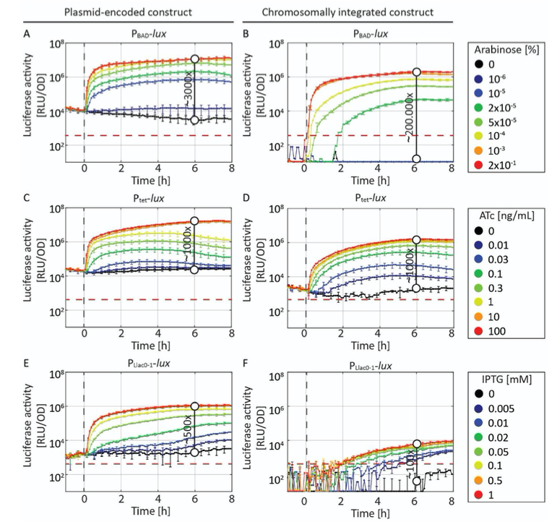
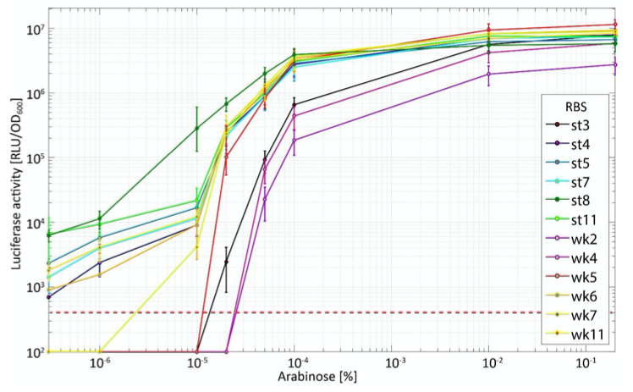
Promoter & RBS characteristics

Slide 36
